Slide 1
Data Structures and Algorithms -3 (25CS2103E)
Interactive Complexity Theory Learning Platform
Team Members
K. Satwik – 2520030446
K. Sai Krishna – 2520030610
K. Charan - 2520030530
Under the Esteemed Guidance of
Dr. CH Anuradha and Dr. Swathi, Department of Computer Science and Engineering

Slide 2
Contents
Abstract
Introduction
Literature survey
Problem Statement and Objectives
Hardware and Software requirements
Results
Conclusion
Future Scope

Slide 3
Abstract
Interactive Learning: Understand P, NP, NP-Complete & NP-Hard concepts visually.
Algorithm Demonstrations: Explore TSP, Knapsack, Vertex Cover & Hamiltonian Cycle.
Graph Visualizations: Interact with different problem structures.
Reductions & Approximation: Demonstrate problem relationships and solution techniques.
Quizzes & Evaluation: Test knowledge and evaluate user-generated problems.
Performance Analysis: Compare algorithms and connect theory with practical implementation.

Slide 4
Introduction
Computational complexity theory helps us understand how efficiently problems can be solved using algorithms. This project focuses on P, NP, NP-Complete, and NP-Hard problems through an interactive learning platform. It uses real-world examples, graph visualizations, algorithm demonstrations, reductions, approximation techniques, and quizzes to simplify complex concepts. The platform also allows users to create and evaluate problem instances while analyzing algorithm performance, providing a practical way to learn complexity theory.

Slide 5
Literature Survey
Existing learning resources explain computational complexity mainly through textbooks, lectures, static diagrams and theoretical examples. Algorithm visualization tools provide better understanding of individual algorithms, but they generally do not combine complexity-class concepts, reductions, approximation algorithms, quizzes and automatic problem evaluation in one platform. This project addresses that gap by integrating these learning features into a single interactive environment.

Slide 6
Problem Statement and Objectives
Problem Statement: Students often find P, NP, NP-Complete and NP-Hard concepts difficult because of their abstract nature and limited opportunities for interactive experimentation.
Objectives:
• Develop an interactive platform for learning complexity classes.
• Visualize graphs, algorithms and problem-solving steps.
• Demonstrate reductions and approximation techniques.
• Provide quizzes and automatic evaluation of problem instances.
• Analyze and compare algorithm performance.

Slide 7
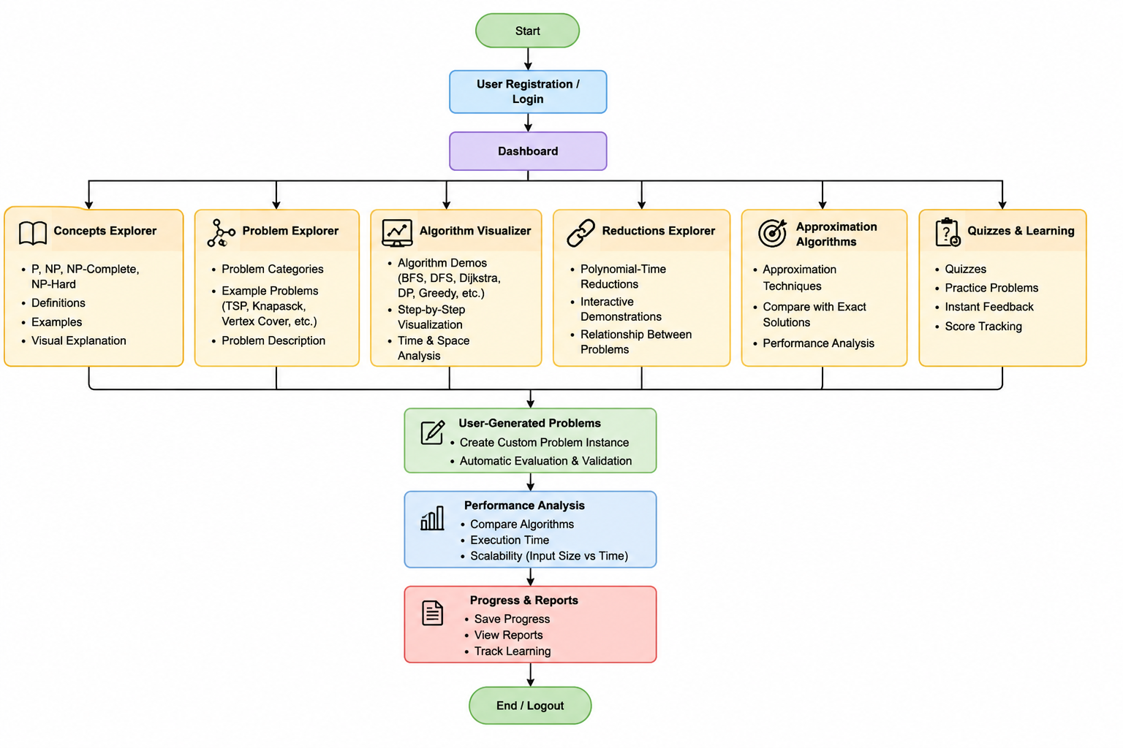
Flow Chart

Slide 8
Conclusion
The project provides a practical and interactive approach to learning computational complexity. By combining visualizations, algorithm demonstrations, reductions, approximation methods, quizzes and performance analysis, it makes P, NP, NP-Complete and NP-Hard concepts easier to understand. The platform bridges the gap between theoretical learning and practical implementation.

Slide 9
Hardware and Software requirements
Hardware:
• Computer/Laptop
• Minimum 4 GB RAM
• Dual-core processor or better
• Internet connection for web-based access
Software:
• HTML, CSS and JavaScript
• Python/appropriate backend technology
• Graph visualization library
• Web browser
• Code editor/IDE

Slide 10
Future Scope
• Add more complexity problems and algorithms.
• Introduce advanced interactive graph visualizations.
• Add adaptive quizzes based on user performance.
• Provide detailed algorithm comparison and analytics.
• Support more user-generated problem types and automated evaluation.

Slide 11
Thank you

